Slide 1
Is Milwaukee Like Portland?
An analysis of neighborhood venue distribution

Slide 2
PDX vs MKE
Article: https://www.salon.com/2014/08/20/milwaukee_is_the_new_portland_partner
Can we determine the “sameness” of cities through venue distribution?

Slide 3
Methodology
https://en.wikipedia.org/wiki/List_of_neighborhoods_of_Milwaukee - we will use this list as the index of neighborhoods in Milwaukee
https://portlandneighborhood.com/portlandzipcodes - we will use this data to identity and come up with centroids for our Portland neighborhoods
https://developer.mapquest.com/documentation/open/geocoding-api/address/get/ -open source geocoder
FourSquare Explorer API for venues in a 500m radius from centroid

Slide 4
Methodology
Get list of neighborhoods per city
Get centroid of neighborhood from OpenMap API
Get venues 500m radius from centroid
One-hot encode
K-Means clustering algo

Slide 5
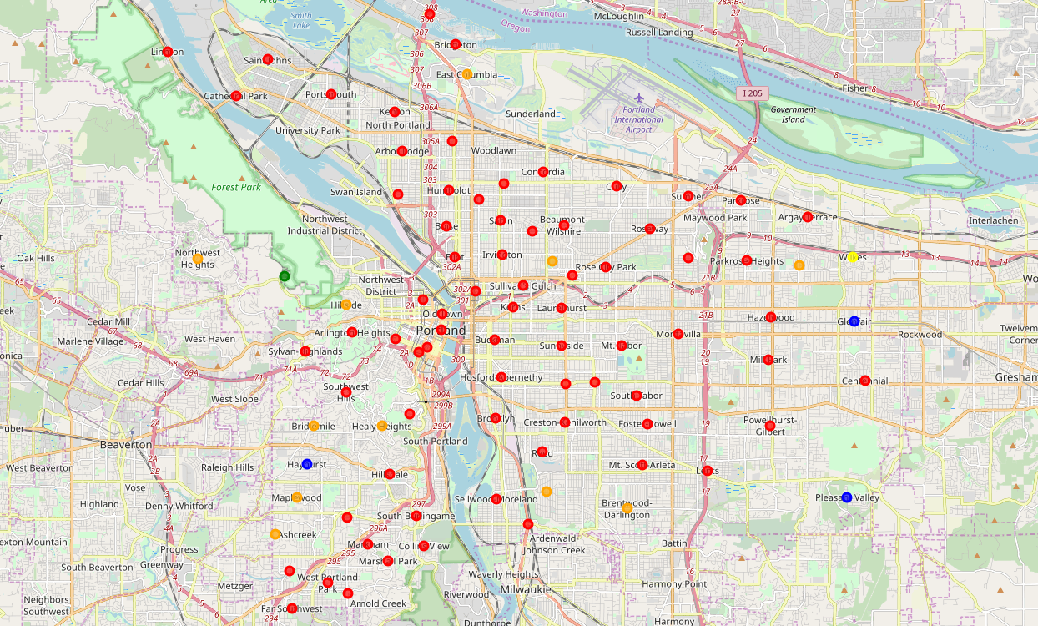
Portland

Slide 6
Portland
5 clusters
Red: “Catch-All”
Orange: “Parks, Fast Food, Event spaces”
Yellow/Green: “Isolated”
Blue: “Park/Zoo/Cooking School” – nearly identical

Slide 7
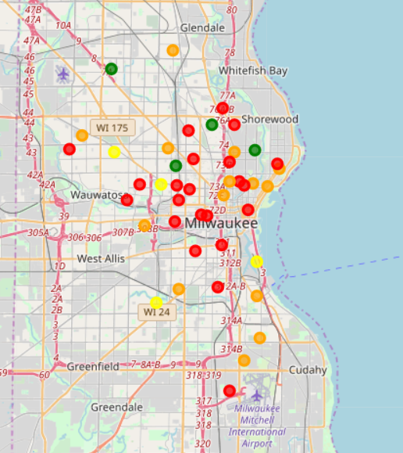
Milwaukee

Slide 8
Milwaukee
4 clusters
Red: “Catch-All”
Orange: “Bars”
Yellow: “Parks”
Green: “Restaurants”

Slide 9
Tale of the Tape
 | Portland | Milwaukee
Population | 647,000 | 595,000
Population Density | 4740 people/sq mi | 5258 people/sq mi
Land Area | 145 mi/sq | 97 mi/sq
Neighborhoods | 88 | 56
Venues | 1830 | 692

Slide 10
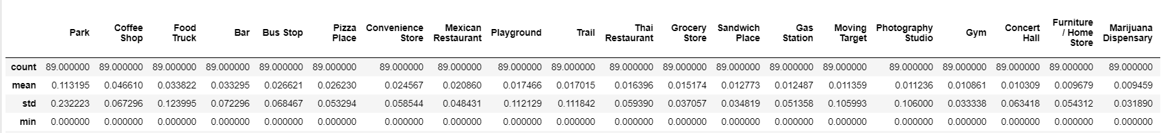
Tale of the Tape - PDX

Slide 11
Tale of the Tape - MKE

Slide 12
Conclusions
Overlap – Parks and bars
Portland has higher venue density and more diversity of venues
Milwaukee is more homogenous and lower venue density
Not very similar in regards to data.

